Slide 1

Global Education Report
Analysis of Education of Different Countries around the world

Slide 2
Brief background
This study aims to explore the various dimensions of educational outcomes in the context of global education. These dimensions include gender differences in educational achievement, degrees of educational completion, and reading and writing ability. The hypothesis suggests that there is a noteworthy relationship between these various aspects of education, with the expectation that differences in one area may affect results in other areas. The aim is to clarify complex connections and identify trends that advance a thorough comprehension of the dynamics of global education.

Slide 3
The Hypothesis
Unemployment is directly related to Education completion rates in the world.
Dataset: -
https://www.kaggle.com/datasets/nelgiriyewithana/world-educational-data/data

Slide 4
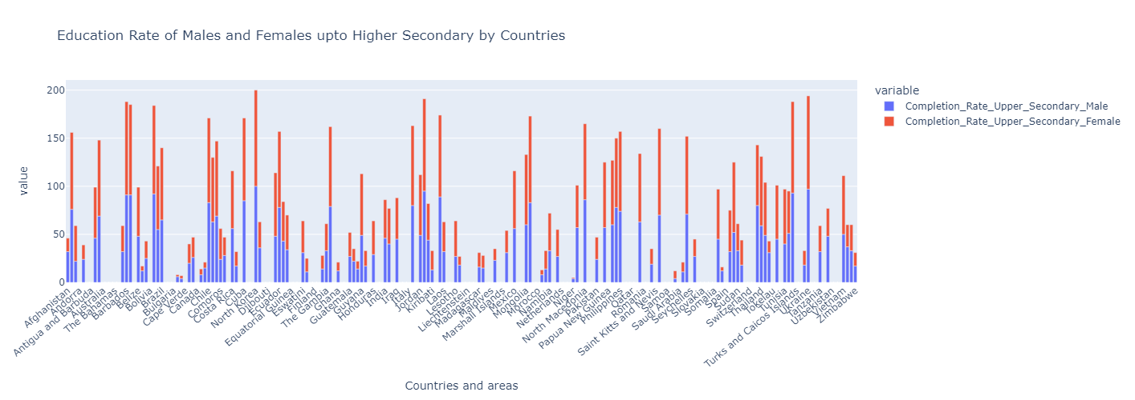
About the dataset
The research uses a diverse dataset that contains education information from multiple nations. The criteria include enrollment rates for men and women, levels of schooling completed, literacy competence, reading and writing proficiency. It also includes the Unemployment rates after the education completion of different countries around the world.

Slide 5
Descriptive analytics
The analysis seeks to offer an understandable summary of the links between several educational dimensions using visual aids such as heatmaps and scatter plots. The intention is to provide readers the ability to identify interdependencies and patterns without assuming any prior knowledge.

Slide 6
Predictive analytics
To prove my hypothesis I need to establish the relation between education and the employment rate around the world. Based on several characteristics, the study attempts to predict educational results using statistical techniques including regression analysis. We need to perform T-test for supporting our claims of co-relation of Education and Unemployment rate.

Slide 7
Discussion and further research
The study's successful components will be examined, with a focus on the regions where correlations are found. The difficulties that arise both theoretically and practically are openly discussed. Subsequent study proposals entail proposing improved data gathering methods to fully capture the complexity of global schooling, taking cultural effects into account, and going deeper into particular area analyses. The goal of this comprehensive approach is to advance a more sophisticated and knowledgeable understanding of the complex connections within the global education system and unemployment problem around the world.

